Slide 1
Protecting your AVR projects with source control
There is nothing so stable as change.
— Bob Dylan
By Roger Pence

Slide 2
What’s in a name?
Source control management
Leading to the popular abbreviation SCM for Source Control Management
SCM is also used as an abbreviation for Software Configuration Management—which generally casts a much wider net than just source code
This discussion is about source code control specifically and uses “SCM” to refer to Source Control Management.
Other names used for SCM
Version control
Change management
Revision control

Slide 3
Why use source control?
Code without regret! SCM makes it is to rewind changes
Avoid tears. SCM serves, at least partly, as a project backup
See change. SCM lets you see code changes
Enable teamwork. Multiple team members can work on the project simultaneously
Make your code accessible. A distributed SCM makes it easy for others to download your code (if you want them to)
Experiment without fear. Try that crazy change you’ve been wanting to knowing you can easily get your original code back if needed
Find where and when your code broke. SCM lets you drill down into code changes
Manage multiple versions. SCM makes it easy to create V2 while continuing to have V1 available
Regulation compliance. Many companies must keep very close track of source changes.
A giant thumb drive in the sky—if you are using a product that uses the distributed model

Slide 4
The check out/ check in model and the merge model.
Check out/check in model
Developer checks out a working copy of a project. An ongoing network connection is needed to see history and changes.
While the project is checked out, it is locked so that no one else can work on it
The project is unlocked when the developer checks changes back in
Some managers prefer this model because it ensures no conflicting changes can be made to the code
Merge model
Developer checks out working copy of a project and also gets all history and changes. No ongoing network connection needed for that after check out.
Developer checks in changes and a manager might need to merge changes to resolve conflicting changes made by simultaneous edits by multiple changes

Slide 5
Centralized versus distributed SCM
Centralized SCM
Client/server oriented
Source code is stored in centralized database
Ongoing network connection required to see history and previous changes
Check-out/check-in and merge models usually both supported
Distributed SCM
Peer-to-peer oriented
Each check out gets both a current working copy of the project and all history and changes
Most distributed models don’t support the check out/check in model—making it likely that at some point conflicting check-ins will need to be resolved by a manager
It sounds scary to most, but the merge model isn’t as bad as it sounds—rarely do multiple teams work on exactly the same parts of the project

Slide 6
Source control products
Commercial products
Perforce
Team Foundation by Microsoft
Vault by SourceGear
Vault is free for a single user!
Open source products
Git
Mercurial
Subversion (aka SVN)
Veracity

Slide 7
Git for the win!
In this video, we’ll take a look at using Git with AVR projects
While a bit daunting at first, Git’s core feature set is actually very simple and easy to use
This is decidedly an opinionated look at how to use Git. I’ll show you what works for me—you decide if this model works for you
If this model doesn’t work for you, find one that does
Coding without source control is like riding a motorcycle with loose spokes. In either case, you’re sure to get bruised and banged up

Slide 8
Just sayin…
Avoid fancy Visual Studio add-ins that attempt to integrate source control into Visual Studio. You might feel comfortable with one of them—I’ve never found one that didn’t end up causing more trouble that it’s worth
Don’t fear the command line
Using SCM is going to slow your workflow productivity down at first—but it catches up and after mastering learning curve you’ll be way ahead of the game!

Slide 9
Collateral
Version Control by Example
http://ericsink.com/vcbe/vcbe_usletter_lo.pdf
The author, Eric Sink, is the CEO of SourceGear. He provides a good introduction to many source control concepts with this free book.
Pro Git
This is a free version of the Apress-published book Pro Git. It is less of a tutorial and more a reference. It covers Git very thoroughly.
https://git-scm.com/book/en/v2
Atlassian Getting Git Right tutorial
https://www.atlassian.com/git/
There are many other Git tutorials on the Web. Get your Google out and find one that makes you happy!
Free Windows Git clients
https://www.atlassian.com/software/sourcetree
https://desktop.github.com/
https://www.gitkraken.com/
Diff tools
WinMerge (http://winmerge.org/) (Free)
DiffMerge (https://sourcegear.com/diffmerge/) (Free)
BeyondCompare (http://www.scootersoftware.com/index.php)
$30-$60 but a great compare/diff utility

Slide 10
Links
Git
https://git-scm.com/
Mercurial
https://www.mercurial-scm.org/
Perforce
http://www.perforce.com/
SourceGear
http://ourcegear.com/vault
SVN
https://subversion.apache.org/
Team Foundation Server
https://www.visualstudio.com/en-us/products/tfs-overview-vs.aspx
Veracity
http://veracity-scm.com/

Slide 11

Installing Git and its components
People seldom do what they believe in. They do what they want, then repent.
— Bob Dylan

Slide 12
Step 1. Getting Git
The first thing we’ll do is install is Git for Windows
Note this isn’t what used to be called GitHub for Windows (that product is now called GitHub Desktop) GitHub for Windows/GitHub Desktop is a graphical Windows client for Git.
In this step we are installing Git itself on our Windows box.
Download installer here
https://git-scm.com

Slide 13
Step 2. WinMerge
WinMerge is a free diff/merge tool. It shows you project and source member differences and it can also be used to merge conflicting changes.
Download its installer here:
http://winmerge.org/

Slide 14
Step 3. SourceTree
SourceTree is Atlassian’s free Git graphical client for Windows
Get the installer here:
https://www.sourcetreeapp.com/
There are other Git clients for Windows
GitHub Desktop – https://desktop.github.com/
GitKraken – https://www.gitkraken.com/
Git itself offers one but it very clunky

Slide 15
Step 4. Get a BitBucket account
Create an account at bitbucket.org
This is the site to which you’ll push your projects
Bitbucket allows unlimited, free, private repositories
GitHub charges for them

Slide 16
Visual Studio Code
Microsoft free code editor. It is very handy for editing text files.
http://code.visualstudio.com/
This is an optional component you can download. You’ll see me using it for editing some files—but you could just as easily use Notepad or another ASCII text editor.
We won’t poke around much with it, but Visual Studio Code also has some interesting Git integration built into it.

Slide 17
Using Git and its components
Learning five Git commands (and one bonus!)
Using SourceTree to look at version differences
Customizing Git
Pushing a Git repo to BitBucket

Slide 18
Git core commands
A quick run-through of some core Git commands
Initialize a git repository (a repo)
git init
Add files to be committed
git add –A
Commit files to git
git commit –m ‘commit message’
Show current working directory status
git status
Show commit log
git log
To clear a Bash screen, use
clear

Slide 19
Git ls-files

Slide 20
Using Git and its components
.gitconfig
http://bit.ly/asna-gitconfig
Copy alias lines to your c:\users\<yourname>\.gitconfig file’s alias section
.gitignore file
http://bit.ly/asna-gitignore
Put the file at the link above in your c:\users\<yourname>\bin folder as .gitignore
Create the bin folder if it isn’t there yet.
With NotePad (or your favorite text editor) put a text file named ‘my-git-init’ in that same folder with these two lines in it:
cp /c/users/roger/bin/.gitignore .
git init
This line ends with a space and then a period. Don’t forget that part!

Slide 21
Setting up SSH
Create a new SSH key
$ ssh-keygen -t rsa -b 4096 -C roger.pence@gmail.com
Press enter
You are prompted for an SSH key file name
The default is: /c/users/roger/.ssh/id_rsa
Press enter to accept the default
Your are prompted for a passphrase
Enter one if you want to
But remember it!
Press enter if you don‘t want to use a passphrase
Press enter again to confirm passphrase

Slide 22
Add your SSH key to the ssh-agent
From the bash command line, start the ssh-agent
eval “$(ssh-agent –s)”
Add the SSH key to the agent
ssh-add ~/.ssh/id_rsa
If you entered a passphrase previously, you’ll be prompted for it

Slide 23
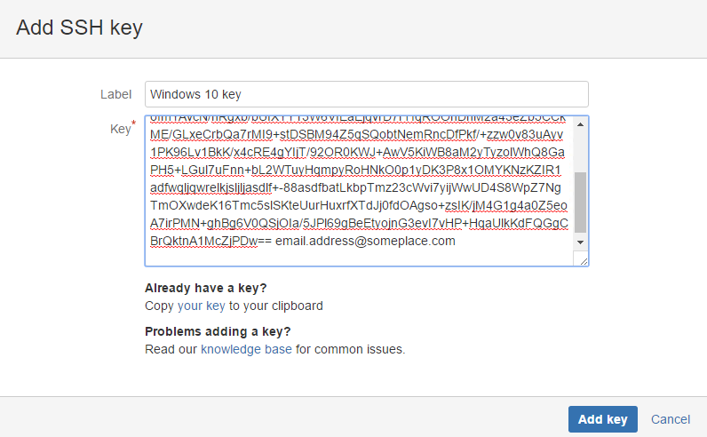
Navigate to the c:\users\roger\.ssh folder
Open id_rsa.pub with a text editor and copy its contents to the clipboard
Add the key to Bitbucket.org

Slide 24
The SSH key passphrase isn’t necessary, but it makes SSH much more secure.
It’s annoying, though, because you’re asked for the phrase every time you push a commit to BitBucket
But, you can configure the Bash command window to prompt for the phrase once (when it opens) to minimize the hassle
In c:\users\<yourname>
.bash_profile
test -f ~/.profile && . ~/.profile
test -f ~/.bashrc && . ~/.bashrc
.bashrc
eval "$(ssh-agent -s)"
ssh-add ~/.ssh/id_rsa

